Slide 1

8th Grade Math: Pre-Algebra
Unit 5, Lesson 10 Solving Real-World Problems on a Coordinate Plane with the Pythagorean Theorem Volume 1, pg. 228

Slide 2


Benchmark
MA.8.GR.1.2
Apply the Pythagorean Theorem to solve mathematical and real-world problems involving the distance between two points in a coordinate plane.
volume 1, pg. 228

Slide 3
Integrated Mathematical Thinking and Reasoning Standards
MA.K12.MTR.1.1 Actively participate in effortful learning both individually and collectively.
MA.K12.MTR.3.1 Complete tasks with mathematical fluency.
MA.K12.MTR.4.1 Engage in discussions that reflect on the mathematical thinking of self and others.
MA.K12.MTR.5.1 Use patterns and structure to help understand and connect mathematical concepts.
MA.K12.MTR.7.1 Apply mathematics to real-world contexts.
volume 1, pg. 228

Slide 4

Learning Targets
I can apply the Pythagorean Theorem to determine the distance between two points on a coordinate plane.
I can apply the Pythagorean Theorem in a real-world context.
volume 1, pg. 228

Slide 5

Warm-Up
volume 1, pg. 229

Slide 6
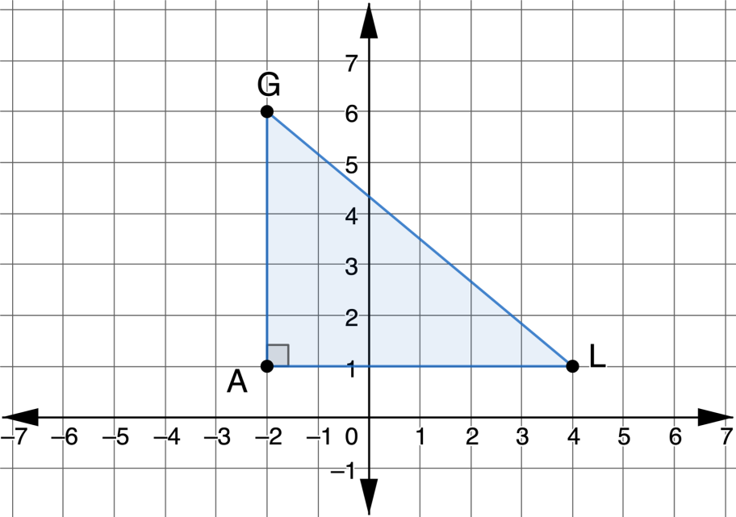

5.10.1 Warm-Up: Bell Work
Triangle $GLA$ is shown on the coordinate plane.
Find the exact length of $\overline{GL}.$
volume 1, pg. 229

Slide 7

Collaboration
volume 1, pg. 229

Slide 8

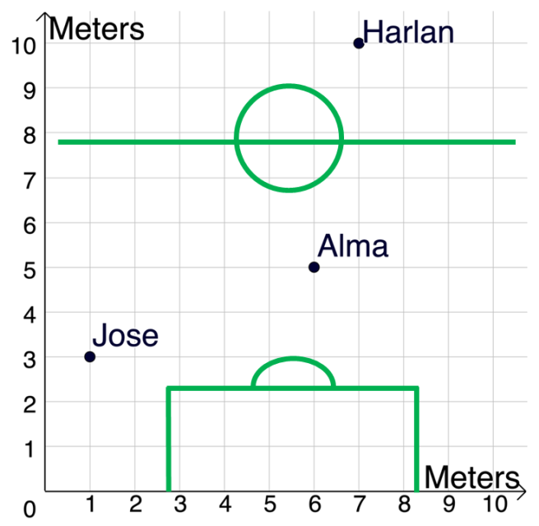
5.10.2 Collaboration: Pass the Ball!
Work with your partner to answer the following questions. The figure shows the position of different soccer players during a recent game. Jose wants to pass the ball to Harlan. He has two options.
Pass the ball directly to Harlan.
Pass the ball to Alma, who can pass the ball to Harlan.
volume 1, pg. 229

Slide 9
Which strategy, A or B, do you think will get the ball to Harlan faster?
How far does the ball travel with strategy A?
How far does the ball travel with strategy B?
volume 1, pg. 229

Slide 10

Jose and Alma pass the ball at different speeds. Jose can kick the ball forward at a rate of $2$ meters per second, while Alma can kick the ball forward at a rate of $4$ meters per second.
Calculate the time that each strategy would take.
$$\frac{Distance}{Rate}=Time$$
How did the actual times for each strategy compare to your prediction?
Jose to Harlan | Jose to Alma | Alma to Harlan
Total Time for Strategy A: | Total Time for Strategy B:
volume 1, pg. 230

Slide 11

Activity
volume 1, pg. 230

Slide 12

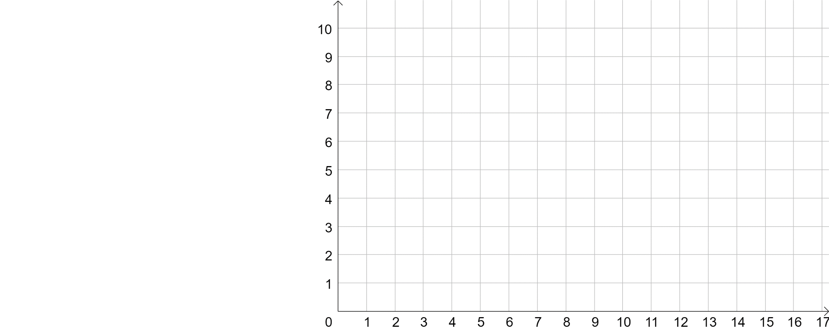
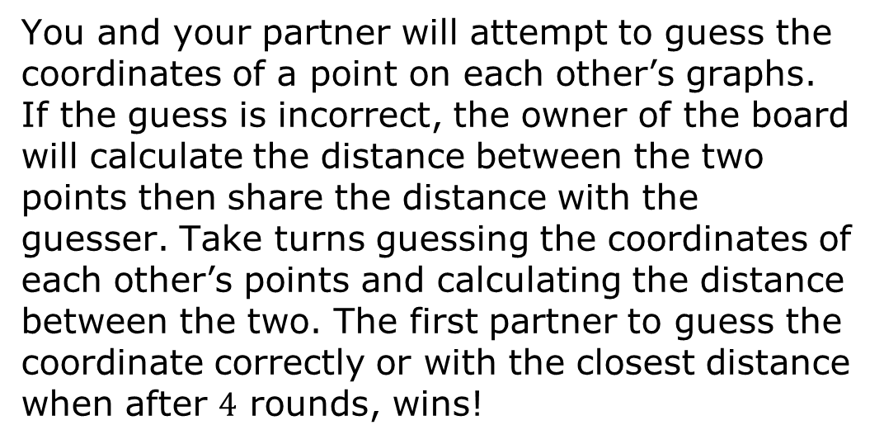
5.10.3 Activity: Target Practice
You and your partner will attempt to guess the coordinates of a point on each other’s graphs. If the guess is incorrect, the owner of the board will calculate the distance between the two points then share the distance with the guesser. Take turns guessing the coordinates of each other’s points and calculating the distance between the two. The first partner to guess the coordinate correctly or with the closest distance when after $4$ rounds, wins!
volume 1, pg. 230

Slide 13
Plot an ordered pair to on the grid (do not let your partner see it).
Record your partner’s guesses and your guesses in the tables below.
Round | Your Point | Partner’s Guess | Distance Calculations
1
2
3
Final Guess
volume 1, pg. 231

Slide 14
Round | Your Guess | Distance From Partner’s Point
1
2
3
Final Guess
What strategies did you use to help determine your next guess?
volume 1, pg. 231

Slide 15

Your Turn
volume 1, pg. 232

Slide 16
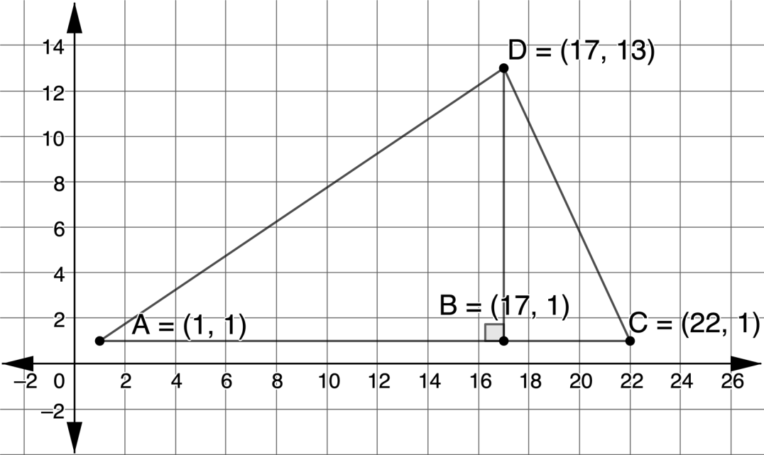

5.10.4 Your Turn!
Triangle $ABD$ is shown on the coordinate plane.
Find the perimeter of Triangle $ABD$.
volume 1, pg. 232

Slide 17
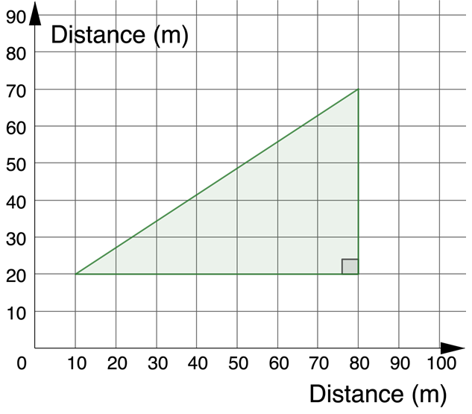
A walkway is constructed around a triangular field, as shown below.
How far is the walk around the field? Round your answer to the nearest tenth.
volume 1, pg. 232

Slide 18

Wrap-Up
volume 1, pg. 233

Slide 19
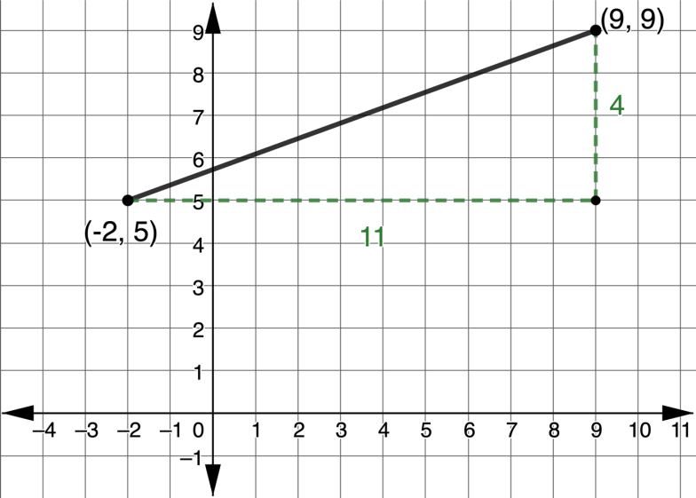
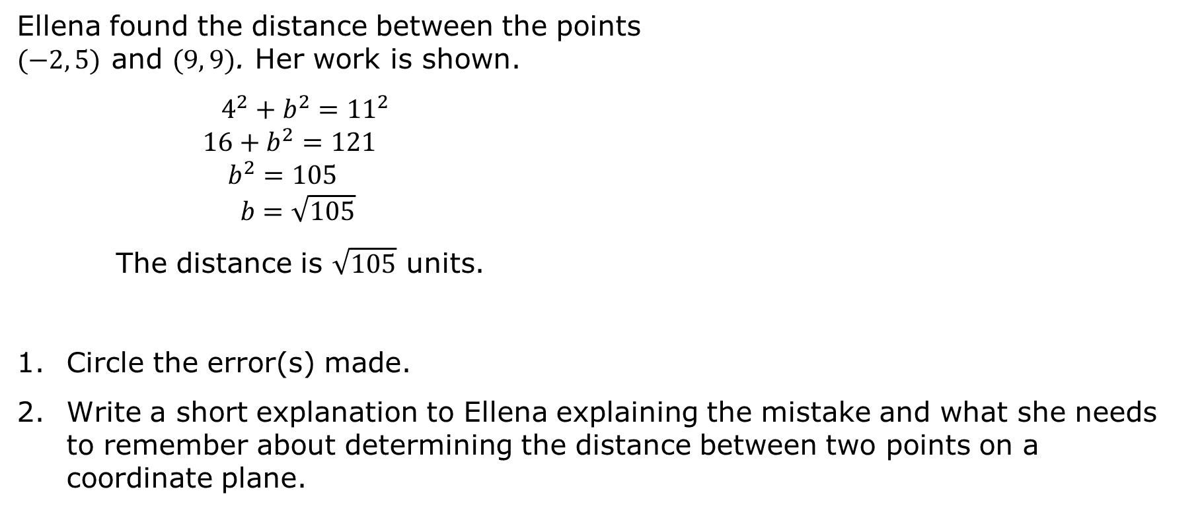
5.10.5 Wrap-Up: Error Analysis
Ellena found the distance between the points $(−2, 5)$ and $(9, 9)$. Her work is shown.
$4^{2}+b^{2}={11}^{2}$
$16+b^{2}=121$
$b^{2}=105$
$b=\sqrt{105}$
The distance is $\sqrt{105}$ units.
Circle the error(s) made.
Write a short explanation to Ellena explaining the mistake and what she needs to remember about determining the distance between two points on a coordinate plane.
volume 1, pg. 233

